Slide 1
DevOps Engineering - Planning to Production
Pranjal Srivastava

Slide 2
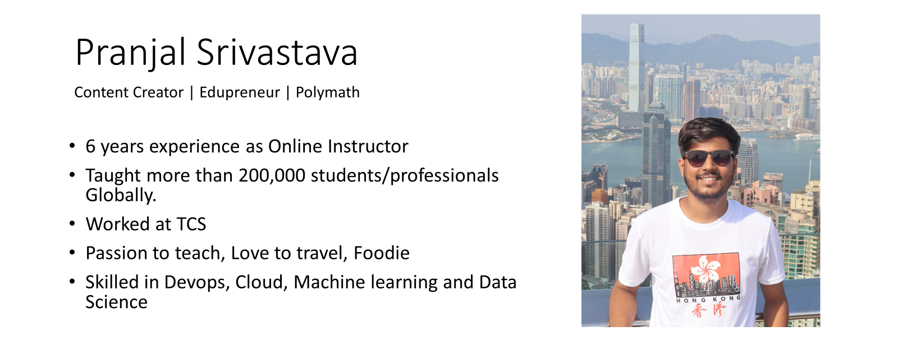
https://www.linkedin.com/in/srivastavapranjal/
https://github.com/iampsrv

Slide 3
Agenda
Course Overview
Preliminary Knowledge
Tools Required
Projects
Assignments
Setup- Github & AWS account
Tools Installation

Slide 4
Tools Required
Visual Studio code or any IDE
Docker Desktop
Minikube
AWS
Git
Github
Ansible
Terraform
Jenkins
Prometheus
Grafana

